Slide 1
Lesson Overview
Group work to update models. 10 mins.
Gallery walk intro, commenting, and guidelines- 8 mins.
Gallery walk first round. 7 mins.
Gallery walk second round. 7 mins (potential for 10).
Gallery walk third round. 7 mins (potential for 10).
Before you go 3 min (if time permits).
Total time- 50 mins.
Notes:
Day 3 Outline
Content goals –
- Decomposers use up air when eating dead matter (in this case dead algae)
- Decomposers grow and multiply
- Decomposers breathe air just like we do (dissolved air in water decreases)
Epistemic goals-
Thoughtful peer critique and uptake of critique makes models better.
Materials
In this lesson students need HO day 3, computers to open model on MEME and class criteria lesson

Slide 2
LESSON 3 - DAY 5

Slide 3

Gallery Walk
This is what your peers (friends) will be evaluating about your models:
Criteria- do the models meet the class criteria?
Supporting Evidence- are all component and mechanisms in the model supported by evidence?
Counter Evidence- is there evidence that goes against (contradicts) a component or mechanism in the model?
Explanation- do they fully explain why the fish are dying?
Notes:
Keep this very brief, just go over slide to help them understand the criteria by which their models will ne evaluated in the gallery walk
As student walk around, this slide will be displayed for them to refer to. It reminds them to attend to the criteria:
do the models use the class criteria? Remind them to look at the class criteria chart and quickly read through what the criteria says to remind them.
Evidence supporting and contradictory- are they supported by evidence?- remind them to look for the green circles to show whether evidence has been linked. If they notice evidence is missing (not linked) can they think of a piece of evidence they could link? This would be a very helpful comment!
Purpose- do they explain why the fish are dying? Is this clear in the model? Are the pieces in to show what leads to fish dying? Is anything missing?

Slide 4
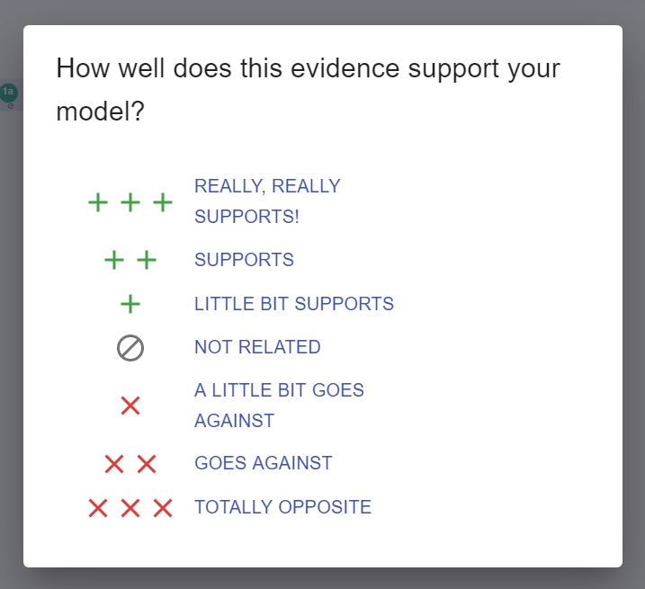
Preparing Models for the Gallery Walk- 10min
Go over each piece of evidence and decide:
Does it provide important information about why the fish died?
Should we add a component or mechanism based on this evidence? If yes- add them!
If you don’t need a piece of evidence you created you can delete it.
Now check your model:
Did you describe the components and mechanisms?
Are your components and mechanisms supported by evidence? Link evidence!
Does your model completely explain why the fish died- the whole story?
Does your model meet the class criteria?
Notes:
Leave this slide up as they work

Slide 5
Now, we will do a...
Gallery Walk
Notes:
Instruction
Tell students that today we will do a gallery walk to view each other’s models on MEME. This gallery walk will be a little bit different, however, because they will view each other’s models on the computer. Emphasize that the gallery walk will be the same but looking at work on the computer instead of on paper. They will still be able to make comments, using the comment feature on MEME, not sticky notes like they might be used to. We will show that to them in a few minutes.

Slide 6
Gallery Walk
In groups you will view other groups’ models.
You will critique the models by writing helpful comments based on our criteria.
You will NOT CHANGE their models or evidence- only comments are allowed.
Your own group will also get helpful comments on your model.
Notes:
Instructions– there are more slides about comments later so don’t dwell on the comments here
Tell them they will need to first carefully read the models, then critique them
They should not change other groups’ models

Slide 7
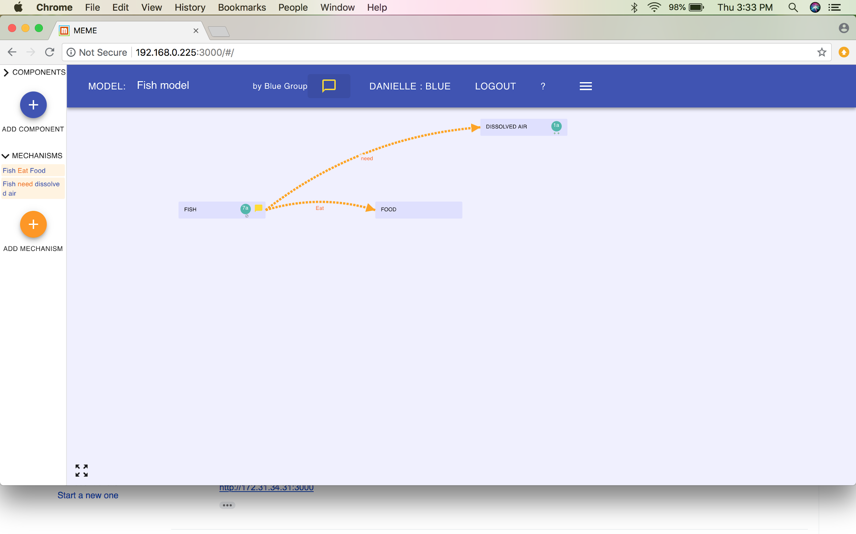
MEME: Comments
To make a comment on MEME:
Step 1: Click on the yellow comment button
Notes:
Instruction
Hand out computers and open MEME, log in using the logins that are taped to the computer. Have students follow along step by step so they know what to do and so we can help them trouble shoot as we go.
To make a comment, first locate the yellow speech bubble icon in the dark purple bar at the top of the screen. Click on the comment button.

Slide 8
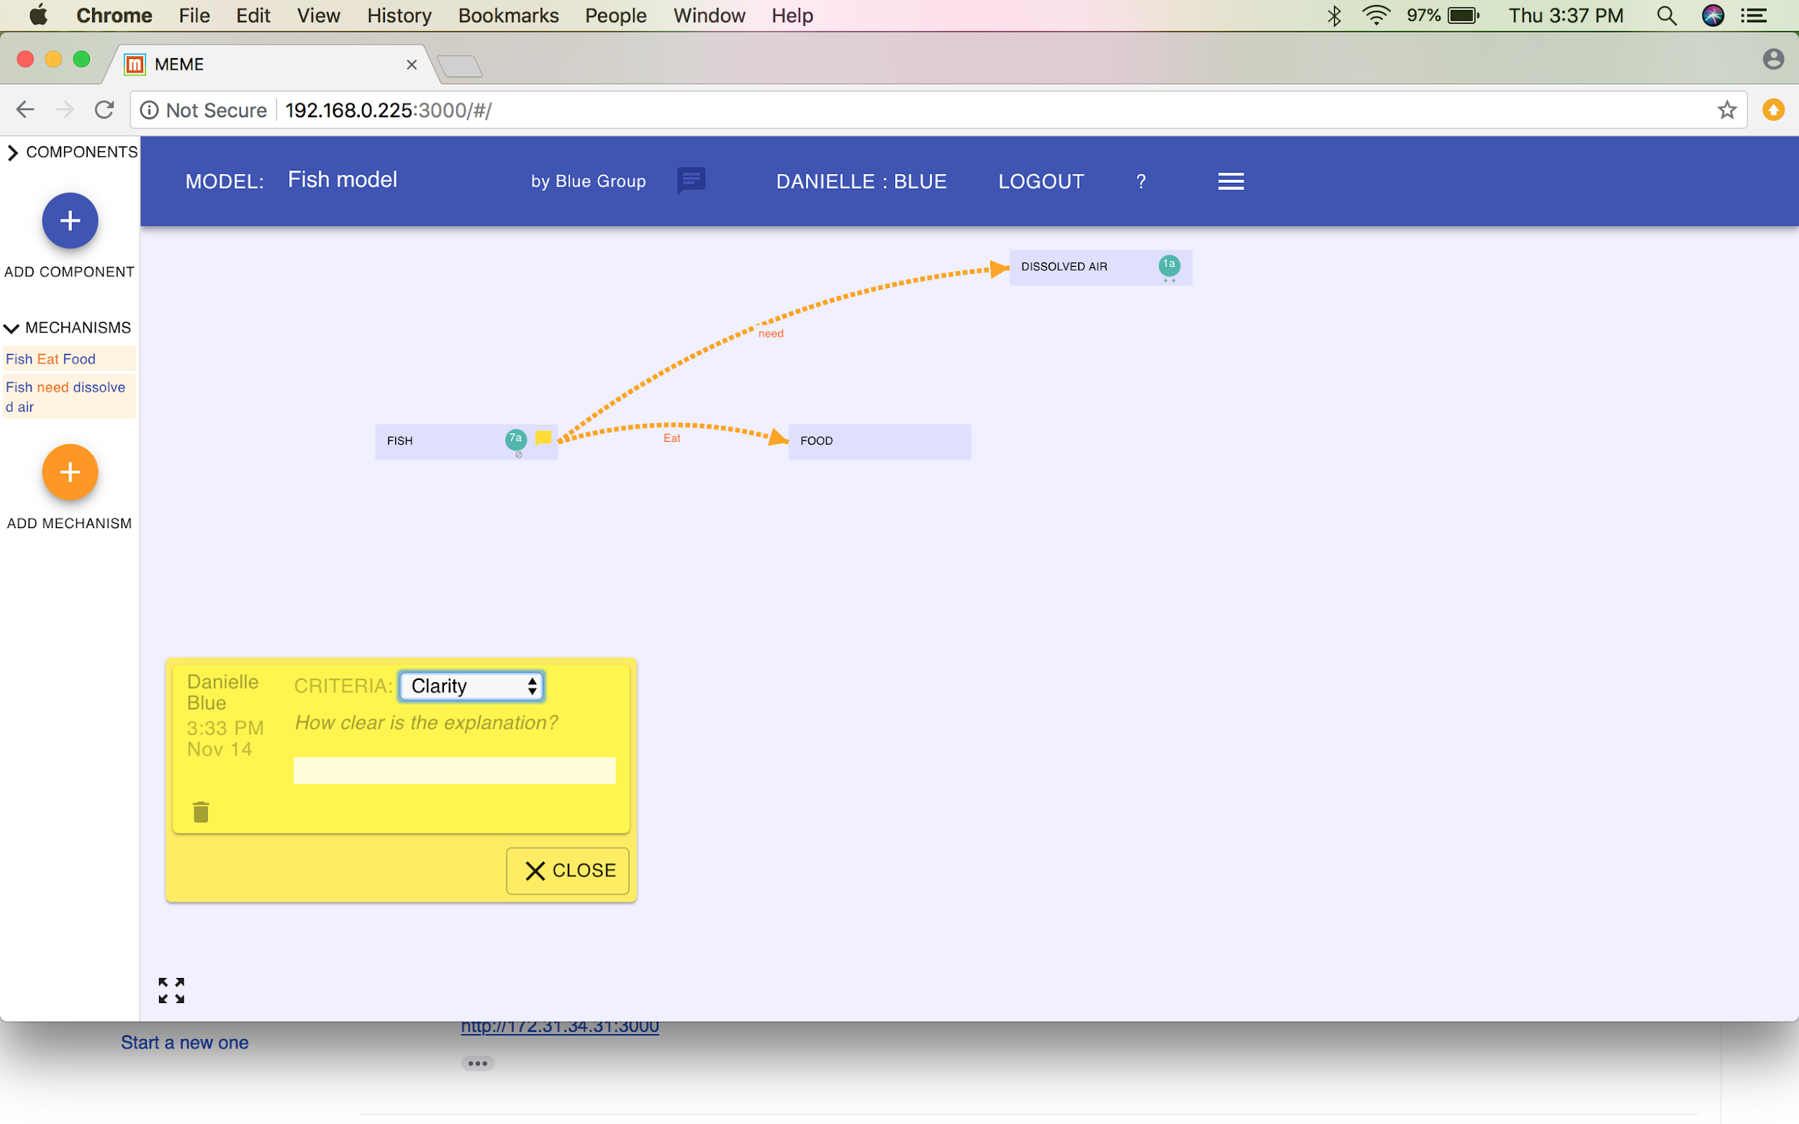
MEME: Comments
You will now see this yellow box.
Step 2: Click on the box next to CRITERIA
Notes:
Instruction
Notice the drop down menu in the box here. This helps us choose what we want to comment on. For example, is it neat and clear or missing labels etc.
More on the next slide...

Slide 9
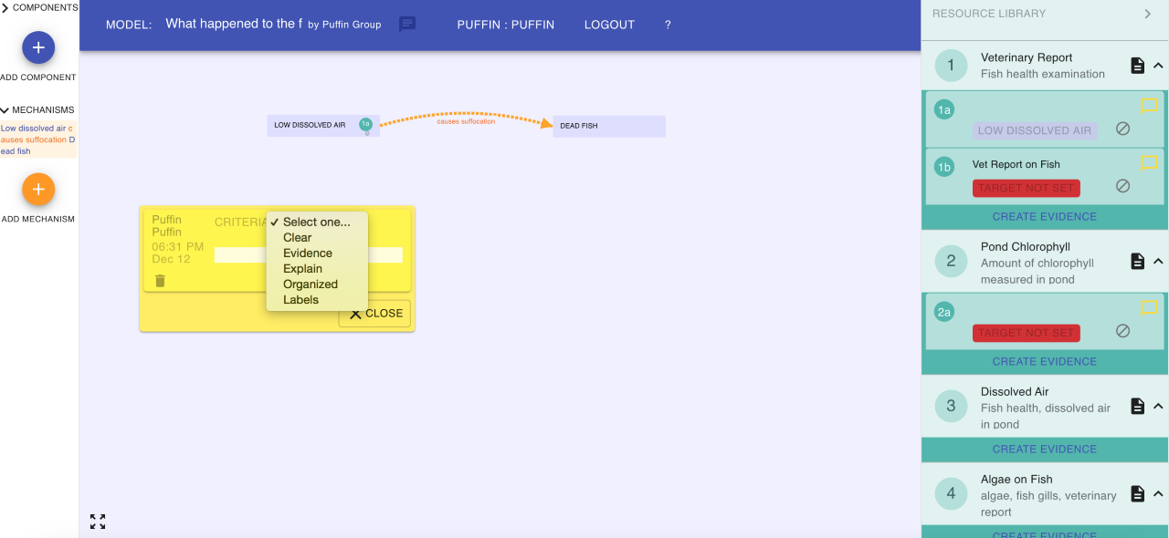
MEME: Comments
Step 3: Select the feature you want to comment on:
Clear
Evidence
Explain
Organized
Labels
These are YOUR class criteria for good models!
Notes:
Now have them select a feature to comment on. For example, do they want to comment on how the model looks (visual)? For example, do all the mechanisms point in the right direction? Are any mechanisms or components missing? If so, name the specific part that needs to be changed.
Do they want to comment on how clear the model is? For this, think about how neat and organized it is or how cramped and close together everything is. Again, comment on the specific piece they would like to see changed. For example, the algae and dissolved air components are too close together so spread them out.
Do they want to comment on something else or something that is not on the criteria list? For example, linking evidence or accurate information. They can do that by selecting “other”.
Names on comments- tell them to include the name of their group on the comment so they know who is it coming from.
For example, Owl: model is unclear because ____ so you can _____ to fix it.

Slide 10
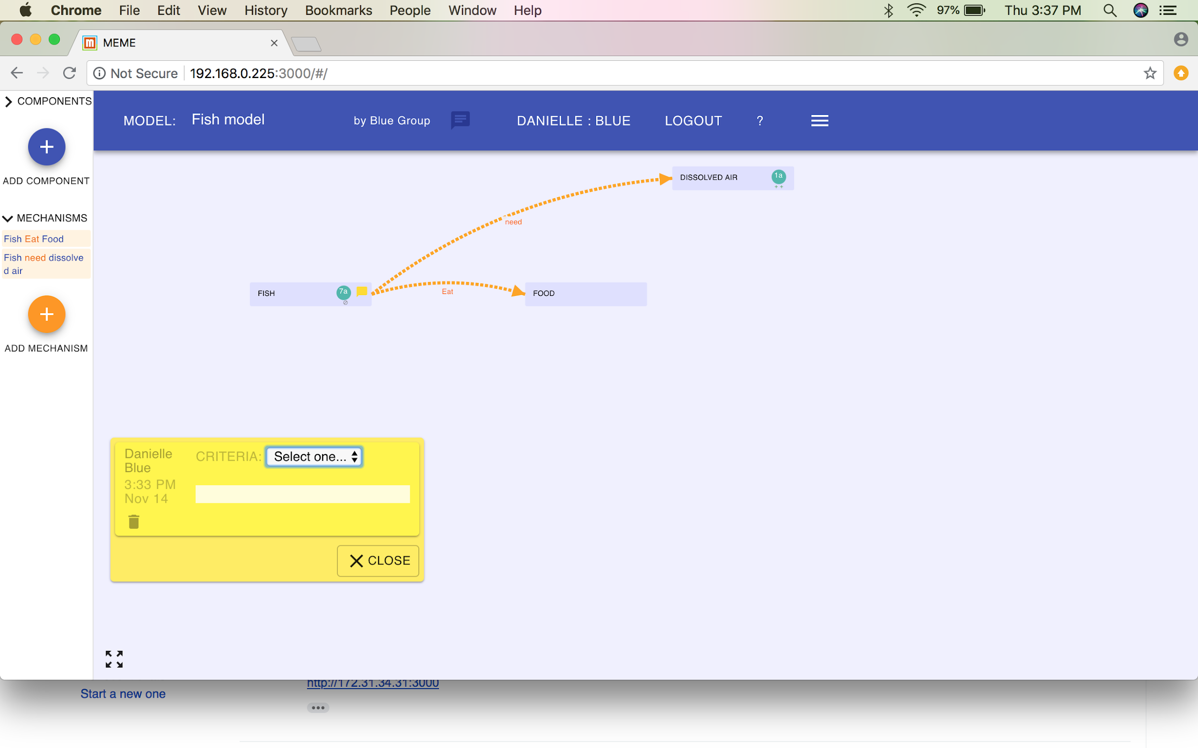
MEME: Comments
Step 4: Type your group’s name and the comment. Then click XClose
You must type your group’s name so they know who wrote the comment, in case they have questions!
Notes:
Instruction- it is really important that they write their group name- Bear, fox, bat etc. (not their actual names)
Now tell them to type in the comment they want to make, using specific examples and click ”close” to save the comment.

Slide 11
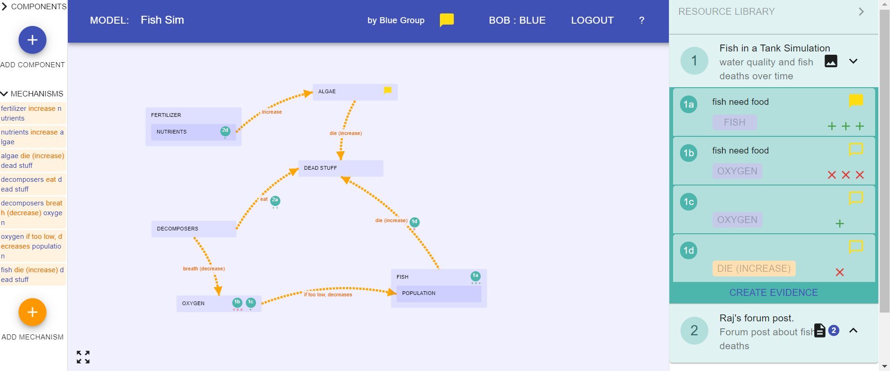

MEME: Comments
Let’s talk about how to make a good comment.
Which comment is the most helpful?
What is going on here??!!
The model is unclear
The model is unclear because the components are all grouped together
Notes:
Instruction
Now tell them we are going to talk about which comments are helpful and which are not. For example, imagine someone told you the model is unclear. Would this help you to change your model? No because you wouldn’t know how to fix it. When giving comments, remember to give specific examples.
Read through the example on the slide, highlighting how the specific example makes the comment so much clearer, which is important to help peers know how to correct parts of their model. Remember we are a learning community, and we want to be as helpful as we can to each other.

Slide 12

MEME: Comments
Let’s talk about how to make a good comment.
Which comment is the most helpful?
Your model is awful!
You are missing a mechanism
You are missing a mechanism between decomposers and dissolved air
Notes:
Instruction
Go through another example of how to make a helpful comment, highlighting the specific example. You can also highlight the word BECAUSE as an important key word to give specific details in the comment.

Slide 13
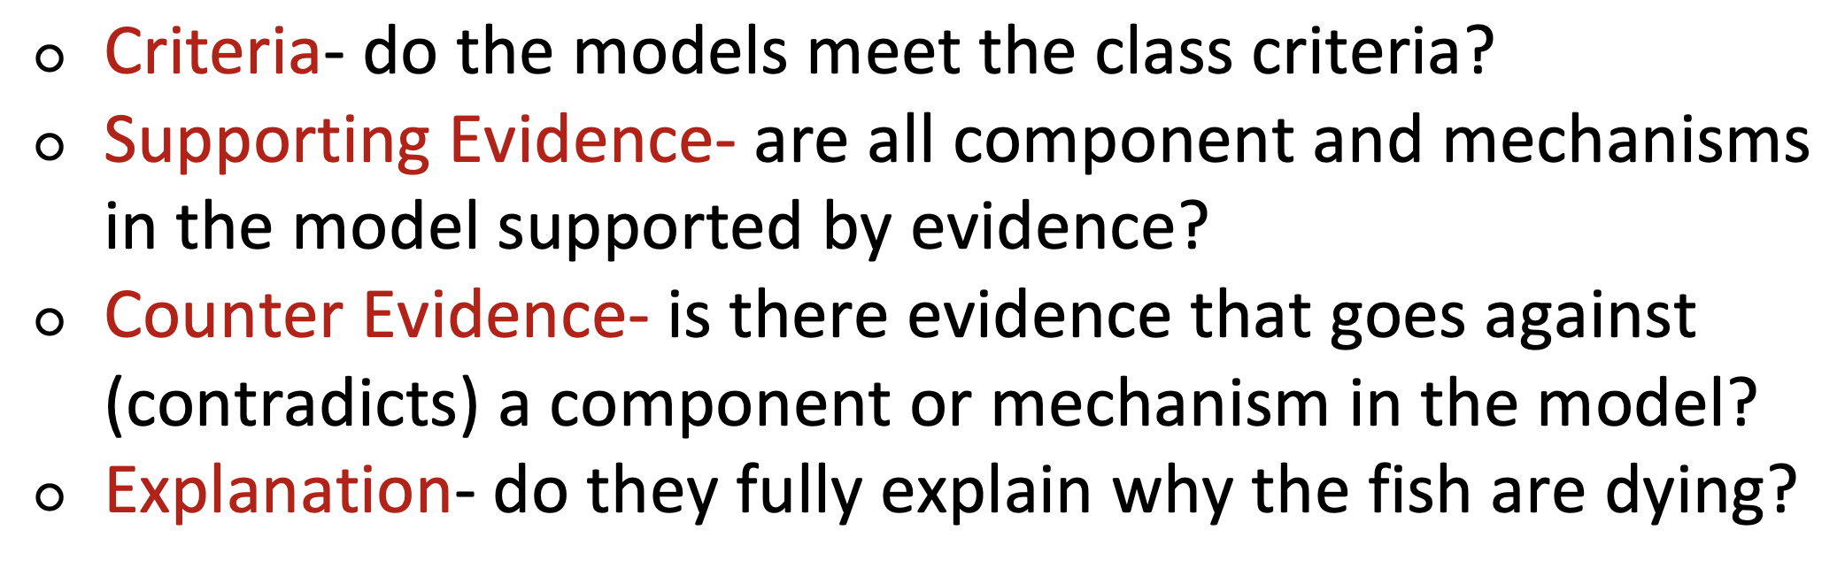
Gallery Walk Guidelines
7 minutes at each station
Rotate to the next computer (clockwise)
Carefully review the entire model:
Write helpful comments! Write your group name!
Notes:
Instructions– leave this slide up as they walk
Share any guidelines you think students need to be able to participate in the gallery walk safely and respectfully. Remind them to have quiet voices, to follow the guidelines on how to leave a comment and be helpful in a comment! We will learn more about this in the next few slides…

Slide 14
BEFORE YOU GO
Answer the BEFORE YOU GO question on a sticky note and paste it on the question board.
Now that you have looked at some other models, what is one change you would like to make to your model to make it better?
Notes:
If there is time have them write the answer on sticky notes

